Slide 1



Winter Camp 2024
Java Programming
Session 3
String and String Buffer
Prepared by: Faculty 4.0 Team

Slide 2
Contents
1
String
2
String Buffer
3
Problem Solving

Slide 3
String Class

Slide 4

String Class in JAVA
A string is a sequence of characters.
In Java, strings are instances of the String class.
Once created, a String object's value cannot be altered, making strings immutable.
For mutable strings, Java provides the StringBuffer class.
The default constructor for a string initializes it to an empty value:
String s = new String();

Slide 5
Creating a String-Some Important ways
To Create a String in JAVA-way 1-String Literals
String str = "abc";
To Create a String in JAVA-way 2-new Keyword/Character Array
char data[] = {'a', 'b', 'c’};
String str = new String(data);
To Create a String in JAVA-way 3- 2-new Keyword/String object
Construct a string object by passing another string object.
String str2 = new String(str);

Slide 6
String Pool-how Java optimizes memory usage
Java optimizes memory usage through the use of the String Pool.
When you create a string literal, Java checks the pool first. If the string already exists, it returns a reference to the existing string without allocating additional memory.
String str1=“Hello”;
Since no such String in the pool,it creates
One and return its reference to str1.
String str2=“Hello”;
Since it is already there,it just assigns
the reference to str2
String Pool
Hello
3e25ae
str1
3e25ae
str2
3e25ae

Slide 7
String Literal Comparison
What is the output ?
public class StringTest
{
public static void main(String[] args)
{
String s1="Hello";
String s2="Hello";
if(s1==s2)
System.out.println("String objects referenced are same");
else
System.out.println("String objects referenced are not same");
}
}
String objects referenced are same

Slide 8
String created using new Keyword
String str1= new String(“Hello”);
It creates a new string in the heap and return the reference
String str2=new String(“Hello”);
It creates the string in the heap and return
the reference
Here in this scenario, though the strings
are same, their reference are different,
since they are created with the new keyword.
str1
3e25ae
Memory Heap
str2
3e25ad
Hello
3e25ae
Hello
3e25ad

Slide 9
String -Comparison
What is the output ?
public class StringTest
{
public static void main(String[] args)
{
String s1=new String (“Hello”);
String s2= new String (“Hello”);
if(s1==s2)
System.out.println("Strings are equal");
else
System.out.println("Strinsg are not equal");
}
}
Strings are not equal

Slide 10
String -Comparison
What is the output ?
public class StringTest
{
public static void main(String[] args)
{
String s1=new String (“Hello”);
String s2= new String (“Hello”);
if(s1==s2)
System.out.println(" String objects referenced are same ");
else
System.out.println("String objects referenced are not same");
}
}
String objects referenced are not same

Slide 11
String -Comparison
What is the output ?
public class StringTest
{
public static void main(String[] args)
{
String s1=new String (“Hello”);
String s2= new String (“Hello”);
if(s1.equals(s2))
System.out.println("Strings are equal");
else
System.out.println("Strinsg are not equal");
}
}
Strings are equal

Slide 12
String Class-Commonly used Methods
The length() method returns the length of the string.
Eg: System.out.println(“Ram”.length());
// prints 3
Characters in a string can be retrieved in a number of ways
public char charAt(int index)
Method returns the character at the specified index. An index ranges from 0 to length() – 1
char c;
c = "abc".charAt(1); // c = “b”

Slide 13
String Class-Commonly used Methods
equals() Method- This method is used to compare the invoking String to the object specified. It will return true, if the argument is not null and it is String object which contains the same sequence of characters as the invoking String.
public boolean equals(Object anObject)
Example:
String str="hello";
System.out.println(str.equals("hello"));//return true
String str="hello";
System.out.println(str.equals(“Hello"));//return false

Slide 14
String Class-Commonly used Methods
equalsIgnoreCase() Method- Compares this String to another String, ignoring case considerations. Two strings are considered equal ignoring case if they are of the same length, and corresponding characters in the two strings are equal ignoring case.
public boolean equalsIgnoreCase(String anotherString)
Example:
String str="hello";
System.out.println(str.equalsIgnoreCase("hello"));//return true
String str="hello";
System.out.println(str.equalsIgnoreCase(“Hello"));//return true

Slide 15
String Class-Commonly used Methods
equalsIgnoreCase() Method- Compares this String to another String, ignoring case considerations. Two strings are considered equal ignoring case if they are of the same length, and corresponding characters in the two strings are equal ignoring case.
public boolean equalsIgnoreCase(String anotherString)
Example:
String str="hello";
System.out.println(str.equalsIgnoreCase("hello"));//return true
String str="hello";
System.out.println(str.equalsIgnoreCase(“Hello"));//return true

Slide 16
String Class-Commonly used Methods
startsWith() – Tests if this string starts with the specified prefix. public boolean startsWith(String prefix) "January".startsWith("Jan"); // true
endsWith() - Tests if this string ends with the specified suffix. public boolean endsWith(String suffix) "January".endsWith("ry"); // true

Slide 17
String Class-Commonly used Methods
compareTo() - Compares two strings and to know which string is bigger or smaller
We will get a negative integer, if this String object is less than the argument string
We will get a positive integer if this String object is greater than the argument string.
We will get a return value 0(zero), if these strings are equal.
public int compareTo(String str)
public int compareToIgnoreCase(String str)
This method is similar to compareTo() method but this does not take the case of strings into consideration.

Slide 18
String Class-Commonly used Methods
indexOf – Searches for the first occurrence of a character or substring. Returns -1 if the character does not occur
public int indexOf(int ch)- It searches for the character represented by ch within this string and returns the index of first occurrence of this character
public int indexOf(String str) - It searches for the substring specified by str within this string and returns the index of first occurrence of this substring
String str = “How was your day today?”;
str.indexof(‘t’);
str(“was”);

Slide 19
String Class-Commonly used Methods
public int indexOf(int ch, int fromIndex)- It searches for the character represented by ch within this string and returns the index of first occurrence of this character starting from the position specified by fromIndex
public int indexOf(String str, int fromIndex) - Returns the index within this string of the
first occurrence of the specified substring, starting at the specified index.
String str = “How was your day today?”;
str.indexof(‘a’, 6);
str(“was”, 2);

Slide 20
String class Methods
String Class-Commonly used Methods
lastIndexOf() –It searches for the last occurrence of a particular character or substring
substring() - This method returns a new string which is actually a substring of this string. It extracts characters starting from the specified index all the way till the end of the string
public String substring(int beginIndex)
Eg: "unhappy".substring(2) returns "happy"
public String substring(int beginIndex, int endIndex)
Eg: "smiles".substring(1, 5) returns "mile“

Slide 21
String Class-Commonly used Methods
concat() - Concatenates the specified string to the end of this string
public String concat(String str) "to".concat("get").concat("her") returns "together"

Slide 22
String Class-Commonly used Methods
replace()- Returns a new string resulting from replacing all occurrences of oldChar in this string with newChar
public String replace(char oldChar, char newChar)
"wipra technalagies".replace('a', 'o') returns "wipro technologies"

Slide 23
String Class-Commonly used Methods
trim() - Returns a copy of the string, with leading and trailing whitespace omitted
public String trim()
String s = “ Hi Mom! “.trim();
S = “Hi Mom!”
valueOf() – This method is used to convert a character array into String. The result is a String representation of argument passed as character array
public static String valueOf(char[] data)

Slide 24
String Class-Commonly used Methods
Other forms are:
public | static | String | valueOf(char c)
public | static | String | valueOf(boolean b)
public | static | String | valueOf(int i)
public | static | String | valueOf(long l)
public | static | String | valueOf(float f)
public static String valueOf(double d)
wipro.com

Slide 25
String Class-Commonly used Methods
toLowerCase(): Method converts all of the characters in a String to lower case
toUpperCase(): Method converts all of the characters in a String to upper case
public String toLowerCase() public String toUpperCase()
Eg: "HELLO WORLD".toLowerCase();
“hello world".toUpperCase();
wipro.com

Slide 26
StringBuffer Class

Slide 27
StringBuffer Class in JAVA
StringBuffer in Java is a peer class of String that provides much of the functionality of strings.
The primary difference between a StringBuffer and a String is that StringBuffer is mutable, meaning it can be modified after it's created.

Slide 28
StringBuffer Class in JAVA
StringBuffer has two main operations methods – append and insert.
Both these methods are overloaded so that they can accept any type of data Here are few append methods:
As the name suggests,
StringBuffer append(String str)
StringBuffer append(int num)
the append method adds the specified characters at the end of the StringBuffer object

Slide 29
StringBuffer Class in JAVA
The insert() method is used to add text at a specified index within the existing StringBuffer or StringBuilder.
Here are few insert methods:
StringBuffer insert(int index, String str)
StringBuffer insert(int index, char ch)
Index specifies at which point the string will be inserted into the invoking StringBuffer object

Slide 30
StringBuffer other methods
delete(int start, int end): Removes the characters within a specified range of this sequence.
deleteCharAt(int index): Removes the character at the specified position.
reverse(): Reverses the sequence of characters in the StringBuffer.
length(): Returns the length (character count) of this sequence
charAt(int index): Returns the character at a specific index.
substring(int start, int end): Returns a new String that contains a subsequence of characters currently contained in this sequence.

Slide 31

Problem Statement 1
Given several passages of text, count the number of specific punctuation marks present in each passage. The punctuation marks of interest are commas
(,), periods (.), and question marks (?).
Input:
The first line contains an integer T denoting the number of test cases.
Each test case consists of a single line of text.
Output:
For each test case, print the count of the specified punctuation marks (commas, periods, and question marks) in a new line.

Slide 32
Problem Statement 1
Example:
Sample Input
2
Hello, how are you doing today? I hope all is well.
What is this? This, clearly, is a test.
Sample Output
3
5

Slide 33

Solution
for (char ch : line.toCharArray()) {
if (ch == ',' || ch == '.' || ch == '?’)
{
punctuationCount++;
}
}
System.out.println(punctuationCount);
}
scanner.close();
}
}
import java.util.Scanner;
public class PunctuationCount {
public static void main(String[] args) {
Scanner scanner = new Scanner(System.in);
int T = Integer.parseInt(scanner.nextLine());
for (int i = 0; i < T; i++) {
String line = scanner.nextLine();
int punctuationCount = 0;

Slide 34
Problem Statement 2
Given a string, s, consisting of alphabets and digits, find the frequency of each digit in the given string.
Input Format
The first line contains a string, num which is the given number.
Constraints
1 ≤ len(num) ≤ 1000
All the elements of num are made of English alphabets and digits.
Output Format
Print ten space-separated integers in a single line denoting the frequency of each digit from 0 to 9.

Slide 35
Problem Statement 2
Sample Input 0
a11472o5t6
Sample Output 0
0 2 1 0 1 1 1 1 0 0
Explanation 0
In the given string:
· 1 occurs two times.
· 2, 4, 5, 6 and 7 occur one time each.
The remaining digits 0, 3, 8 and 9 don't occur at all.

Slide 36
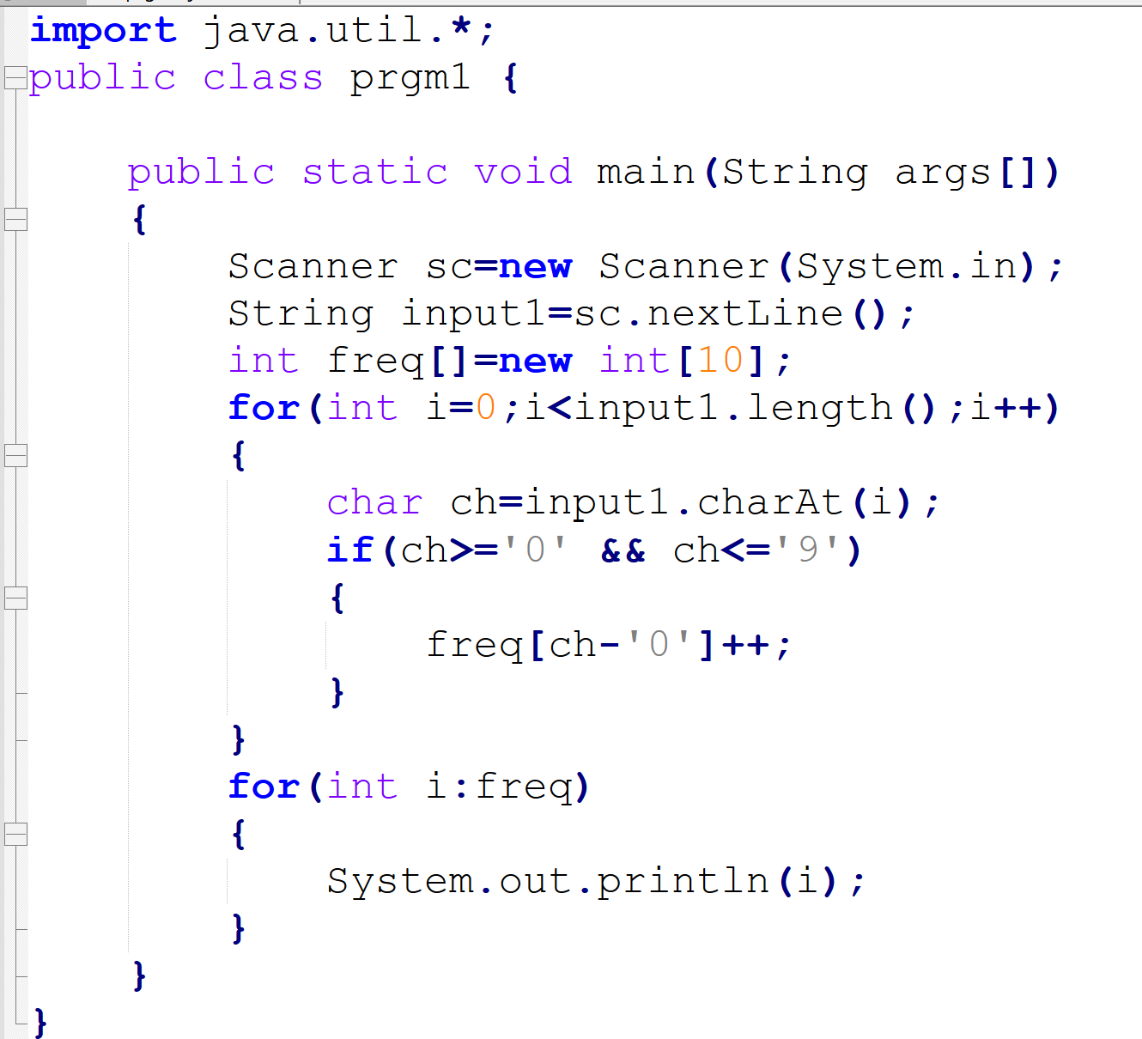
Solution

Slide 37
Problem Statement 3
Bechan Chacha is seeking help to filter out valid mobile numbers from a list provided by his crush. He can only pick his crush's number from this list if it consists entirely of valid mobile numbers. A mobile number is deemed valid if it has exactly 10 digits, consists only of numeric values, and does not begin with a zero.
Task: Determine whether each mobile number in the list is valid or not based on the given criteria.
Input:
An integer T, the number of mobile numbers to check.
Followed by T lines, each containing a string S which represents a mobile number.
Output:
For each mobile number S, print "YES" if it is valid and "NO" if it is invalid.
Constraints:
1 <= T <= 1000
The combined length of all mobile numbers does not exceed 100,000.
Sample Input:
3 1234567890 0123456789 0123456.87
Sample Output:
objectivec
YES NO NO

Slide 38
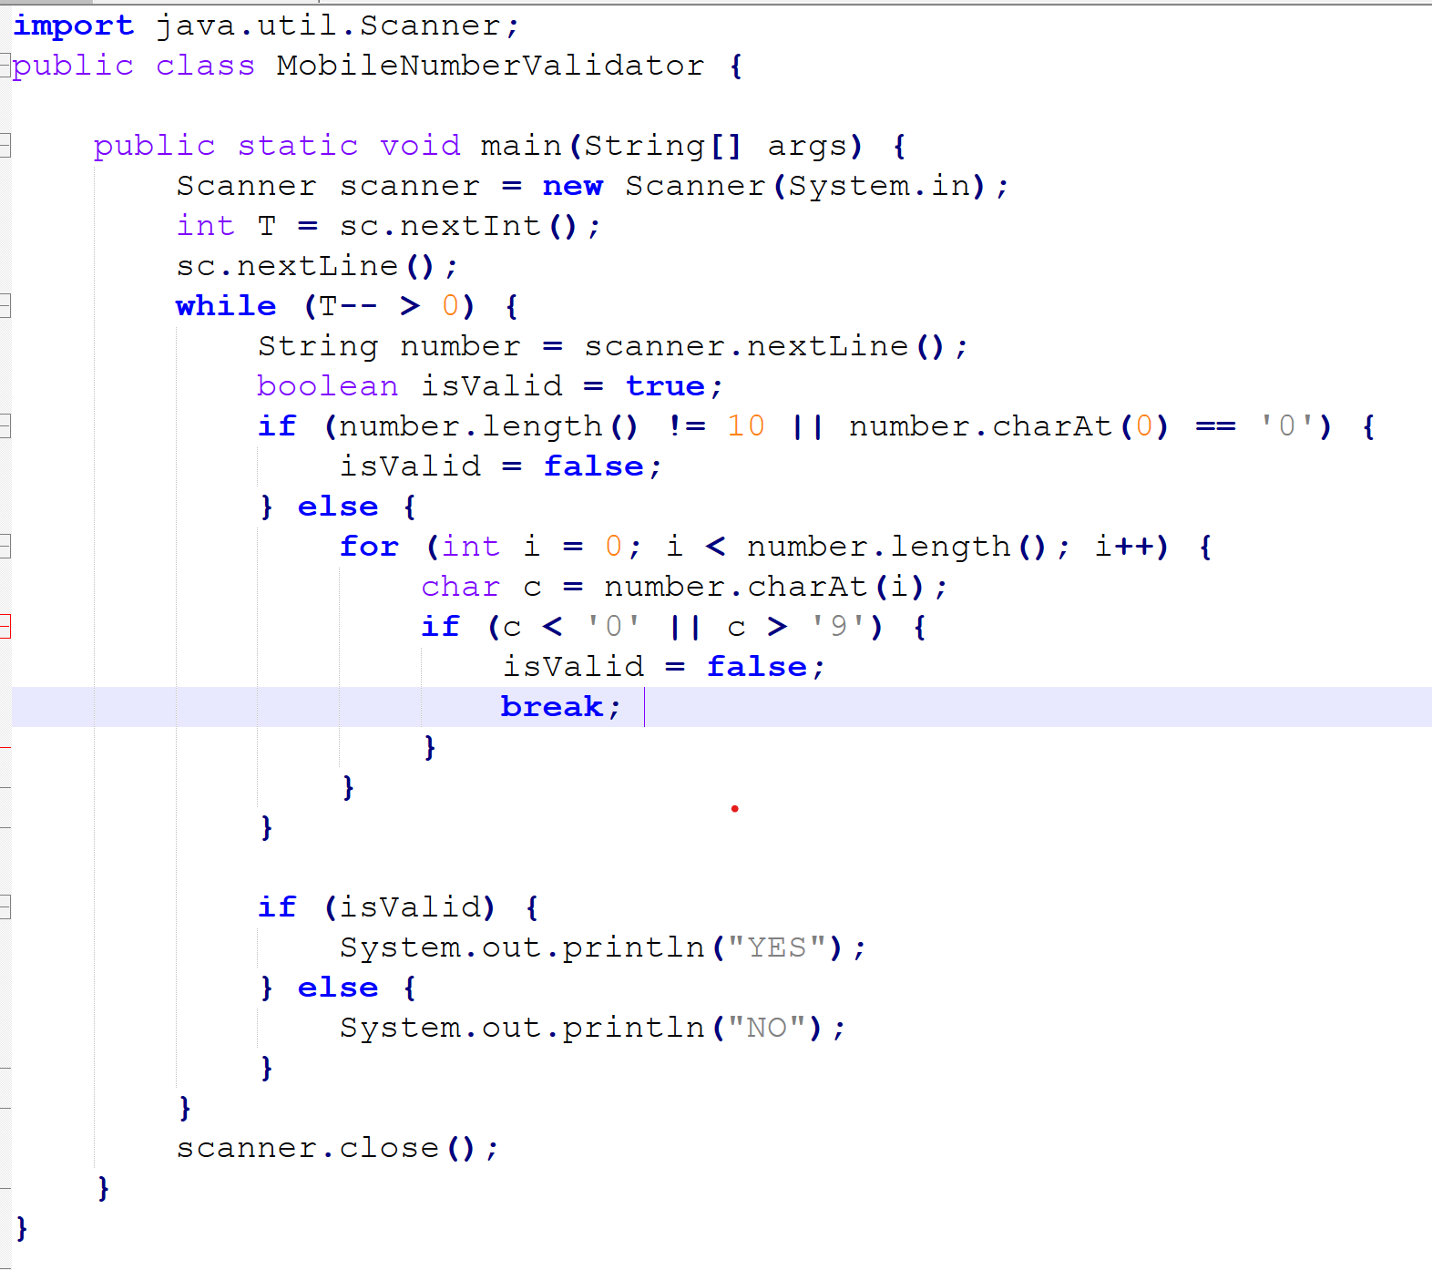
Solution

Slide 39
Problem Statement 4
Joey loves to eat Pizza. But he is worried as the quality of pizza made by most of the restaurants is deteriorating. The last few pizzas ordered by him did not taste good :(. Joey is feeling extremely hungry and wants to eat pizza. But he is confused about the restaurant from where he should order. As always he asks Chandler for help.
Chandler suggests that Joey should give each restaurant some points, and then choose the restaurant having maximum points. If more than one restaurant has same points, Joey can choose the one with lexicographically smallest name.
Joey has assigned points to all the restaurants, but can't figure out which restaurant satisfies Chandler's criteria. Can you help him out?
Input:
First line has N, the total number of restaurants.
Next N lines contain Name of Restaurant and Points awarded by Joey, separated by a space. Restaurant name has no spaces, all lowercase letters and will not be more than 20 characters.
Output:
Print the name of the restaurant that Joey should choose.

Slide 40
Problem Statement 4
Constraints:
1 <= N <= 105
1 <= Points <= 106
SAMPLE INPUT
3
Pizzeria 108
Dominos 145
Pizzapizza 49
SAMPLE OUTPUT
Dominos
Explanation
Dominos has maximum points.

Slide 41
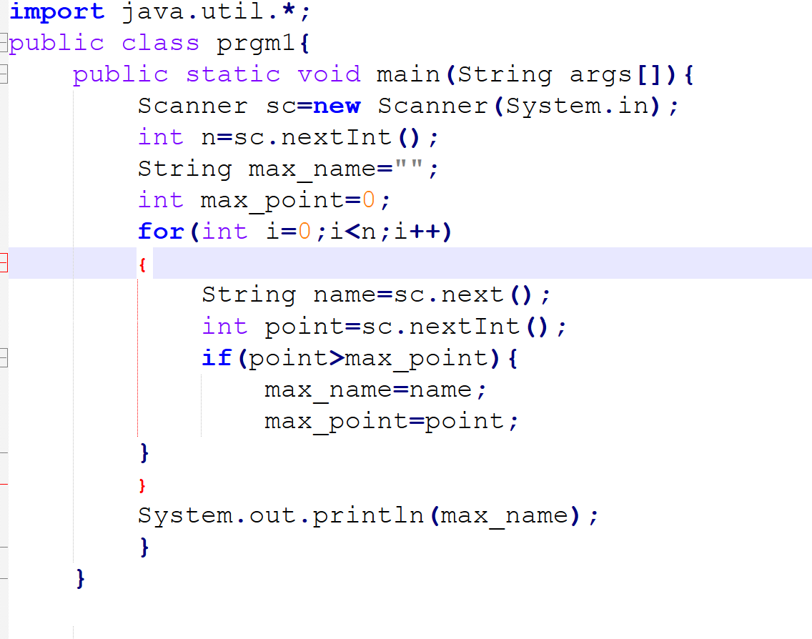
Solution

Slide 42
Problem Statement 5
Write a program that takes as input a string (sentence), and returns its second word in uppercase.
For example:
If input1 is “Wipro Technologies Bangalore” the program should return “TECHNOLOGIES”
If input1 is “Hello World” the program should return “WORLD”
If input1 is “Hello” the program should return “LESS”
NOTE 1: If input1 is a sentence with less than 2 words, the program should return the word “LESS”.
NOTE 2: The result should have no leading or trailing spaces.

Slide 43
Solution
public class Solution {
public static void main(String args[] ) {
Scanner sc = new Scanner(System.in);
String str = sc.nextLine();
String str1[] = str.split(" ");
if(str1.length<2)
System.out.println("LESS");
else
System.out.println(str1[1].toUpperCase());
}
}

Slide 44
Thank you!

